Slide 1
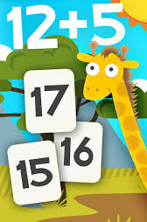
Math Fun Game

Slide 2
CS595(G) Capstone
Proposal for Fun Math Game

Slide 3
Team
Name | Id
Satyavani Kanuri | 13879
Anudeep Marella | 18349
Geethika Valluri | 16030
Monica Pulli | 17222

Slide 4
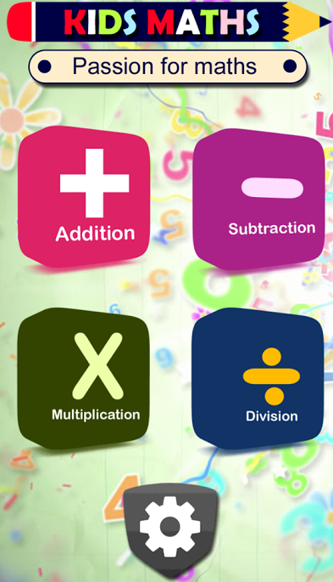
Project Goal
Develop a fun Math Game for Kids.
The application helps kids develop math skills by introducing fun in learning Math.
This App is Offline Android Game

Slide 5
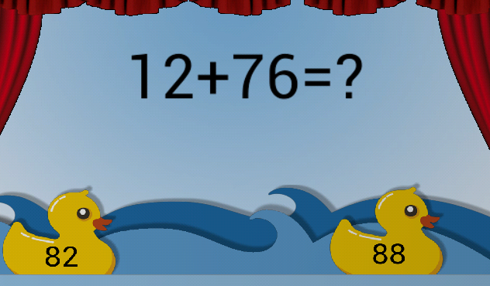
Project Details
The game is very user friendly and fun. The focus is on kids who love mathematics in a fun way(6-12 years).
The game provides different levels like Addition, Subtraction, Multiplication, Division.
The player needs to answer the math equation appearing on the animals.
The users can choose different backgrounds.
The game provides a great range of number operations which provide the brain teasing and fun to users.

Slide 6
Modules
User Navigation
Questions and Images.
Animation
Scores (Animal Collections).

Slide 7
Technology & Tools
Application Layer | Technology
Language | Java
Libraries | Android SDK
Testing | Android Emulator

Slide 8
Thank You.

